Slide 1
Section 8.2
The Inverse Trigonometric Functions (Continued)
Copyright © 2012 Pearson Education, Inc. Publishing as Prentice Hall.

Slide 2
Copyright © 2012 Pearson Education, Inc. Publishing as Prentice Hall.

Slide 3


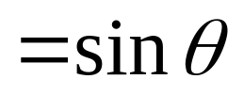
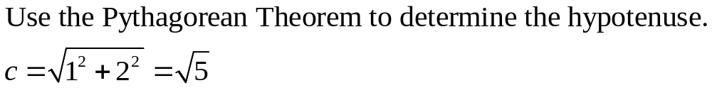
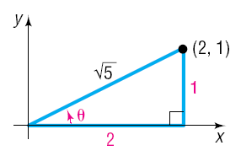
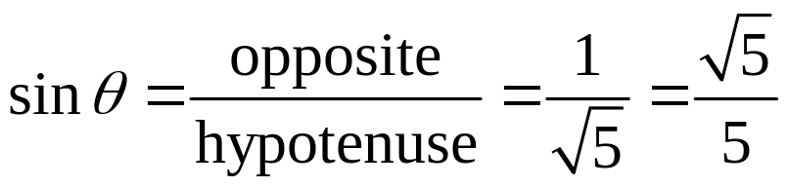
Copyright © 2012 Pearson Education, Inc. Publishing as Prentice Hall.

Slide 4


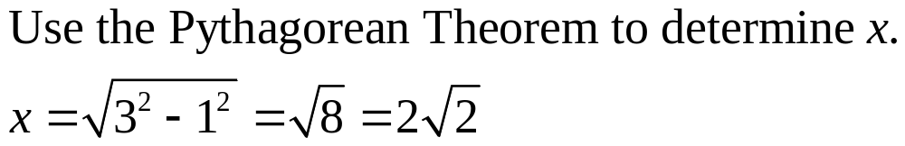
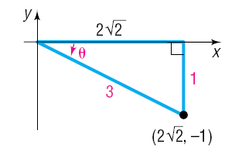
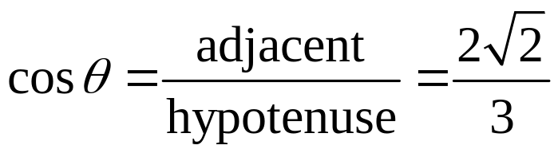
Copyright © 2012 Pearson Education, Inc. Publishing as Prentice Hall.

Slide 5


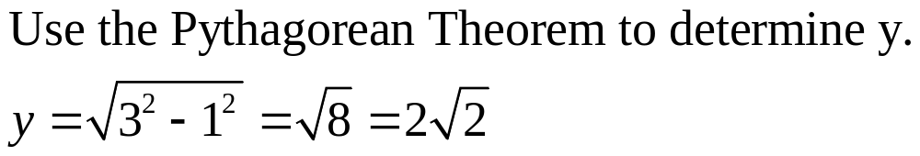
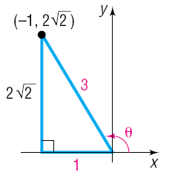
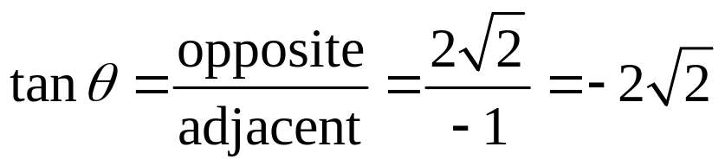
Copyright © 2012 Pearson Education, Inc. Publishing as Prentice Hall.

Slide 6

Copyright © 2012 Pearson Education, Inc. Publishing as Prentice Hall.

Slide 7
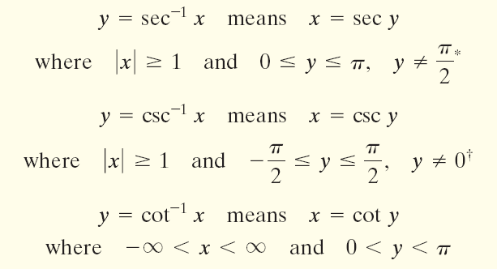
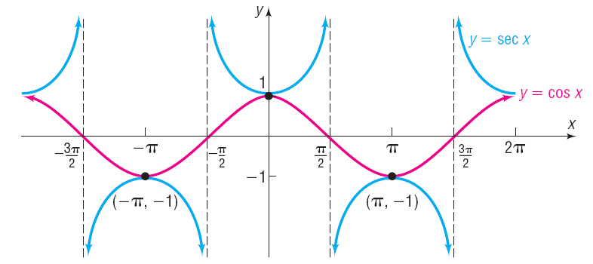
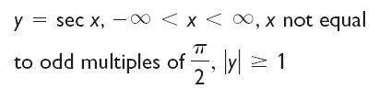
Copyright © 2012 Pearson Education, Inc. Publishing as Prentice Hall.

Slide 8
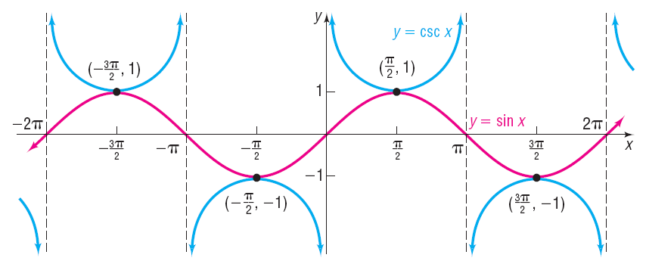

Copyright © 2012 Pearson Education, Inc. Publishing as Prentice Hall.

Slide 9
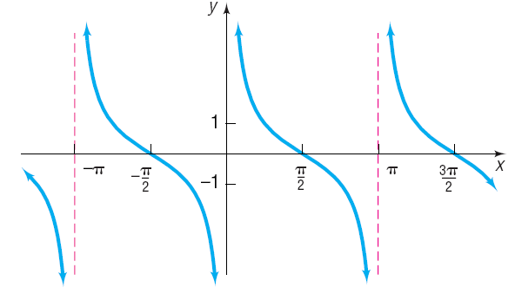
Copyright © 2012 Pearson Education, Inc. Publishing as Prentice Hall.

Slide 10

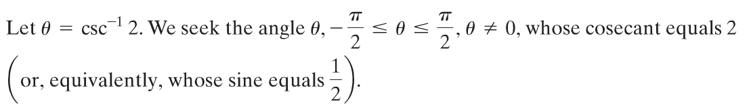
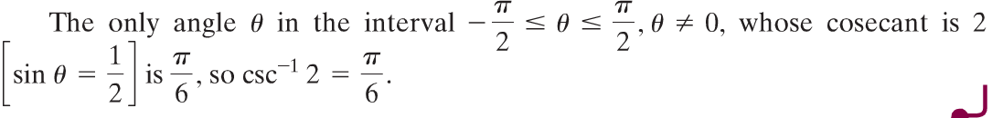
Copyright © 2012 Pearson Education, Inc. Publishing as Prentice Hall.

Slide 11
Copyright © 2012 Pearson Education, Inc. Publishing as Prentice Hall.

Slide 12
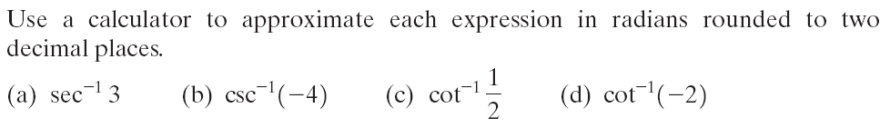

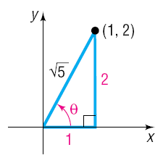


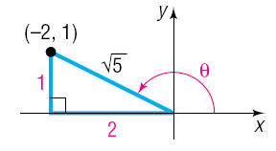

Copyright © 2012 Pearson Education, Inc. Publishing as Prentice Hall.

Slide 13
Copyright © 2012 Pearson Education, Inc. Publishing as Prentice Hall.

Slide 14
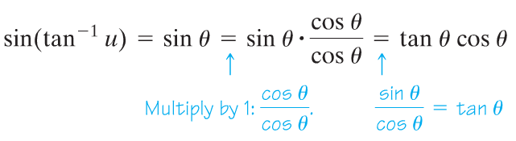
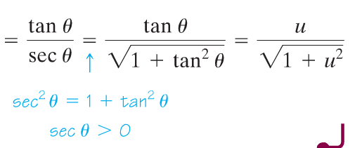
Copyright © 2012 Pearson Education, Inc. Publishing as Prentice Hall.

